Slide 1
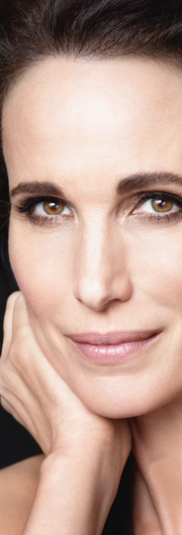
L’Oréal of Paris
Jordan Borkland
Vinay Gandhi
Jocelyn Green
Matthew Kopyt
Katie Marquardt
Bringing Class to Mass
with Plénitude

Slide 2
Introduction
A brief background of L'Oréal, Plénitude, and their entry to the US.

Slide 3
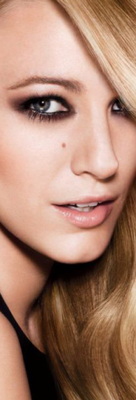
About L'Oréal of Paris
Offering all women and men worldwide the best of cosmetics innovation in terms of quality, efficacy, and safety.
Born from a desire for technological innovation
Focus on innovative cosmetics technology
"Trickle Down and Fire Up" strategy
Reliant on strong advertising and merchandising
Notes:
Background of L’Oréal, “Class to Mass” (1 minute)
L'Oréal was founded in France in 1907 and was born from a desire for technological innovation in hair color. L'Oréal maintained a focus on innovation as the company grew, and today, their mission statement is “Offering all women and men worldwide the best of cosmetics innovation in terms of quality, efficacy, and safety.”
Their longtime strategy of “Trickle Down and Fire Up,” has been a key to their success. The company develops product technology for their high-end brands (like Lancôme and Biotherm), then that technology is “trickled down” into their more widely distributed brands; those sold in drugstores, mass merchants, and grocery stores.
It's important to note for this case, while brands like Lancôme are supported in the department stores with sales representatives to help customers understand the products, the more widely distributed brands rely on strong advertising, merchandising and promotions to sell the product.

Slide 4
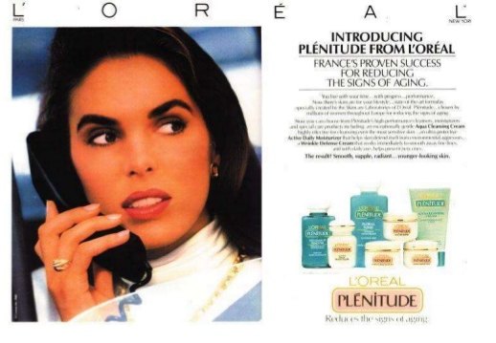
L'Oréal Plénitude in France
Plénitude Line Introduced in 1982
One of L'Oréal's first ventures beyond haircare and cosmetics
Positioned as high-end, yet accessible
Marketing message focused on the modern woman and technologically advanced products
An early success in France and additional products were developed
Notes:
The Plenitude Brand (1 minute)
The brand was introduced in France in 1982 and was one of L'Oréal's first ventures beyond haircare and cosmetics. They positioned the brand as high-end with superior performance, yet accessible for women.
Their marketing message, which was mostly delivered through print ads as was standard practice for prestige brands, focused on the modern woman, using technologically advanced products. This ad is of course the US version from 1992, but gives an idea of the message used in France.
The brand was an early success in France and L'Oréal developed additional products to complement the initial moisturizer. This print ad shows the various products that were developed.

Slide 5
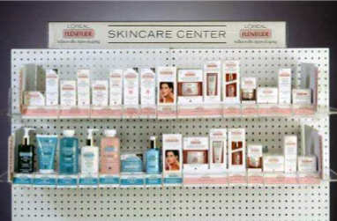
L'Oréal Plénitude Entry in the U.S.
Introduced to the US in 1988 and 1989
Successful test market in Atlanta and Dallas in 1988
Retailers required to sell the entire line with moisturizers and cleansers
Challenge: L'Oréal's first products in the HBA aisles
Opportunity: L'Oréal's is well-known for their innovative cosmetics and hair care
Notes:
Entry of Plenitude in US (1 minute)
Introduced in US in 1988, test marketed in Atlanta and Dallas, then introduced nationwide after very positive results. L'Oréal required retailers to carry all 14 SKUs so that the entire line of products was available to shoppers – which you can see here in the planogram. The 14 products fell within three categories: basic moisturizers, treatment moisturizers, and cleansers.
The challenge for L'Oréal US was that they were well known for their cosmetics, but did not have products in the Health and Beauty Aids (HBA). By making this move, they would be competing against strong competitors: Olay, Ponds and Neutrogena (we'll talk about that more later). But their strength lies in their technological innovation, which they had made clear with their cosmetics and hair care brands in the US.
They would rely on strong advertising and merchandising to make up for not having the department store environment with helpful sales people.

Slide 6
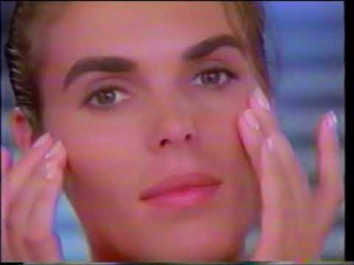
L'Oréal Plénitude Wrinkle Defense Cream
1989 Television Ad Introducing Plénitude to US
Notes:
Entry of Plenitude in US cont.
Advertisement: https://www.youtube.com/watch?v=qw-kwNGRxmA
Year-one sales, took 2nd place behind Oil of Olay.

Slide 7
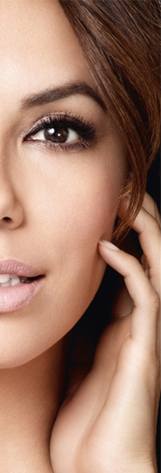
PLÉNITUDE GOALS IN THE US
Four Keys:
Improve the top-line
Bottom line moving in the right direction
Make the US a major contributor to global position
Ensure US products are suitable for US customers while fitting within L'Oréal's technology portfolio
Notes:
Goals for Plentitude and the Case (2 minutes)
Senior Vice President of Marketing, Carol Hamilton, details four keys for the branding team:
Improve the top-line: we need to break through the four-year sales plateau and increase sales in order to maintain a strong position.
Bottom line moving in the right direction: L'Oréal lost 12.5 million on the brand in 1995. L'Oréal does not require a profit in 1996, but we want to be moving in the direction to start turning a profit soon.
Make the US a major contributor to the brand’s position globally. In 1994, L'Oréal US went from an exclusive licensee to an owned subsidiary. We want to ensure L'Oréal US has a strong role in the global management of the brand.
We need to ensure the US products are suitable for US customers, while fitting within L'Oréal's technology portfolio.
This leads us to the situation analysis and the several pages of market research you have all read…

Slide 8
Situational Analysis
An analysis of the competition, position and consumer research.
Notes:
To start off the situational analysis, I'm going to pass it over to Vinay to explore Plenitude's competition.

Slide 9
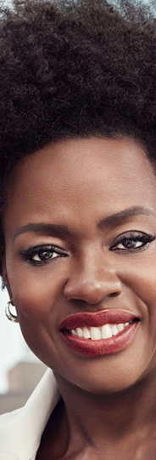
Competition
Skin Care
Moisturizers
  Daily moisturizers vs. treatment moisturizers
Cleaners
P&G's : Oil of Olay
Nivea
Notes:
When Plenitude became a hit or successful in France , It expanded in different markets like US.
For company to be in mass channel it was clear to be in Health and Beauty Aids section, where 80% of the business was with Olay, Ponds, Neutrogena and Nivea
The graph on the right shows each brand's percentage of sales of daily moisturizers (the Blue portion) versus the percentage of sales of treatment moisturizers (the Yellow portion).

Slide 10
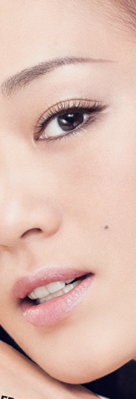
Market Size and Brand Share
Moisturizers Market Size
Notes:
We also looked at the market size and its growth and brand share for different product lines
What we observed was Dollar Volume was increasing year over year, which means market is growing.
However during the same period when we saw the brand share , it was a different picture.
Plenitude showed some increase in first year , and not so much in the remaining years. Olay was going down , where as Ponds and Alpha-Hydrox where increasing dramatically.

Slide 11
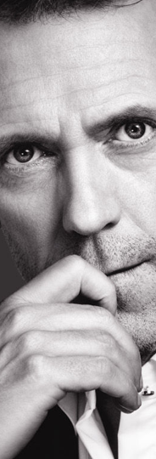
Market Size and Brand Share
Brand Share of Moisturizers
Notes:
We also looked at the market size and its growth and brand share for different product lines
What we observed was Dollar Volume was increasing year over year, which means market is growing.
However during the same period when we saw the brand share , it was a different picture.
Plenitude showed some increase in first year , and not so much in the remaining years. Olay was going down , where as Ponds and Alpha-Hydrox where increasing dramatically.

Slide 12
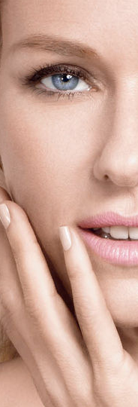
Brand Development
L'Oréal Plénitude vs. Competitors: Familiarity and Experience
Notes:
During Market research we found a lot of concerns regarding brand of Loreal which we will cover in a bit,
One thing that we wanted to check was how are people familiar with the brand , and what have been their experience.
What we observed was Oil of Olay and Ponds where the most familiar brands to people, and less aware of Loreal Plenitude.
However when we added another matrix of how many people tried the product , difference grew significant.

Slide 13
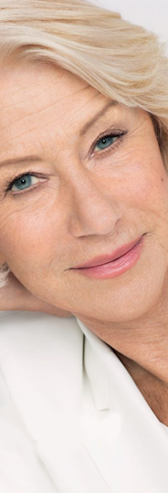
Three Types of Studies
Custom Market Research Studies Commissioned for Plénitude
Facial Skin Market Study
Qualitative study among acceptors and rejectors of Pléntitude
Plénitude Self-Shopping Study
  Telephone and mail survey
  Over 3,500 women ages 16–69
  Use one or more moisturizers or treatment creams at least once a week
  People who have used Pléntitude
      Four 2-hr focus groups in Boston and Dallas
  Acceptors and rejectors of Olay and Ponds
  Ten groups of 5 people each
  Exposed to mockup of Pléntitude shelf
  Asked to evaluate on shopability
Notes:
Qualitative study among acceptors and rejectors of Pléntitude
Based on Olay and Ponds study
People who have used Pléntitude
Acceptors – still using the brand
Rejectors – stopped using the brand
Four 2-hr focus groups in Boston and Dallas
Acceptors and rejectors of Olay and Ponds

Slide 14
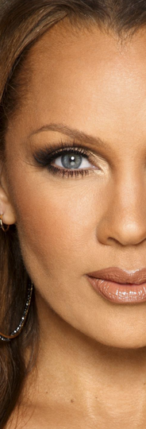
Qualitative study: acceptors and rejectors
Pléntitude
Olay & Ponds
Motivation for trial
  L'Oréal brand name
  Pléntitude as a name meant little to people
Response to product formulas
  Young rejectors found it too heavy
Perception of Pléntitude as a product line
  Large number of products
  Names for products could be more distinguishable
Response to packaging
  Attractive but overworked
Perceived target customer
  Targeted to older women
Motivation for trial
  Olay had many mechanisms
  Ponds was a life staple
Product Satisfaction Sources
  Olay is light and reasonably priced
  Ponds is reliable, accessible, reasonably priced
Brand Imagery
  Olay is traditional and generational
  Ponds is older, down to earth
Perceptions of Pléntitude packaging
  Overwhelming
Notes:
Acceptor/Rejector Studies Perceptions
L'Oréal means more to people than Plénitude
People saw Plénitude as having a very large number of products
Some felt like this was positive, and some negative
Some felt like Pléntiude was specifically targeting older women
The acceptor/rejector studies showed a lot about the perceptions of the brand within the U.S.
L'Oréal meant more to people than Plenitude
Most people within the study always went to the name L'Oréal. They did not know that Plenitude was the name of the brand or even meant anything at all.
When thinking of L'Oréal, people thought that the products were more expensive but better quality
People saw the Plenitude line as having a large number of products
Some felt that this was a positive aspect because it offers a lot which makes it seem to be more researched and top of the line
Some felt like this was a negative thing because all of the products made the line very confusing and complicated. People felt like they don’t have the time to read about all of the options and figure out which one is the best product.
The names of the products mainly confused people. They want to be able to read the name and know what the product is/does
Some felt like Plenitude specifically was targeting older women because of all the aging products

Slide 15
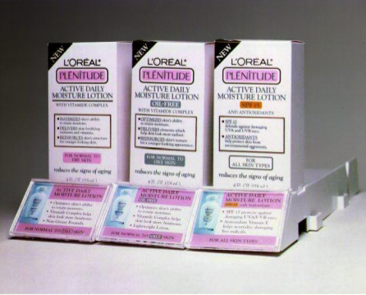
Plénitude self-shopping study
Overall category and shopping experience
  It is fun to see what is new
  Overwhelmed by all of the options
Brand images of major competitors
  Oil of Olay and Ponds are for older women
  L'Oréal (Pléntitude) is a step up but expensive because it is French
L'Oréal product line presentation
  The packaging is chaotic and wordy
  The product looks complicated
  Some people liked all the information featured on the front of the box

Slide 16
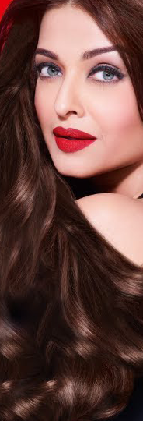
Perceptions of the plénitude brand
Facial Skin Care Market Study
  Brand Imagery Perceptual Map (Exhibit 9) and Brand User Imagery Perceptual Map (Exhibit 10)
    L'Oreal Plenitude, Este Lauder, Clinique, Nivea Visage, Alpha Hydrox, Oil of Olay, Avon, and Ponds
    In most people's minds, Plenitude is:
      Technologically advanced
      Exfoliates the skin
      Contains AHA
      For people who like to spend money on themselves
      For stylish people
      For the upper class
      For aged people - "in their 40's" and "in their 60's"
Notes:
Perceptions of Plenitude brand
Facial Skin Care Market Study showed different perceptions with the perceptual mapping exercise
Exhibit 9 and 10 show the specific maps
Brand Imagery
Plenitude was among the top with “technology advanced”, “exfoliate the skin”, and “contain AHA”
Brand User Imagery
Plenitude was among the top with “like to spend money on themselves”, Stylish upper class”, “Glamorous, sophisticated”, and “Romanic, feminine, in their 40’s"
Perceptual map:
How consumers "see" brands
Consumers are asked to rate each brand on different dimensions
Asked to agree/disagree

Slide 17
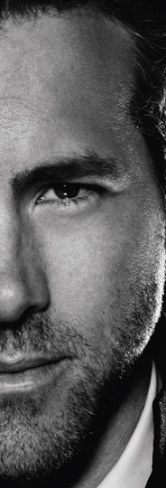
Segmenting
54% of current users fall into these segments
"Stressed Out"
  Not concerned with price
  Want effective product that reduces signs of aging
"Age-Focused"
  Pay more attention to price and natural ingredients
“Modern executive woman who is up-to-date and assertive“
Opportunity with younger segment
  More price sensitive
  Appreciative of simplicity
Notes:
NEXT: Introducing our recommendations, Katie

Slide 18
The
Plénitude Plan
Our recommendations and plans to implement.

Slide 19
Our Recommendations
Five recommendations to meet the brand team's goals
L'Oréal Brand Name
The Product Line
Plénitude Packaging
Promotional Strategies
The Customer Experience
Notes:
The L’Oréal Brand Name: In the market research, we found that the L’Oréal brand name resonated well, but people did not recognize or care about the Plénitude name. Jordan will explain how and why we recommend deemphasizing the Plenitude branding and instead emphasize the L’Oréal name.
The Product Line: The market research also revealed that consumers felt the Plenitude regimen is not easily distinguishable. Matt will help us understand how L’Oréal can market the products to specific age groups, so customers easily understand which products should purchase.
Plenitude Packaging: In the acceptor/rejector studies, several women pointed out that the product packaging felt confusing and overwhelming. This doesn’t give consumers a good first impression of the products, so Vinay will address how L’Oréal can work to improve their packaging.
Promotional Strategies: In the Facial Skin Care Market Study, we found that both awareness and trial have a lot of room to grow. L’Oréal needs to work harder to emphasize the trial of their products. And Jocelyn has some recommendations for the team to follow.
The Customer Experience: We want to make sure L’Oréal is able to create the department store experience in the HBA aisles of drugstores and big box stores. All of the previous recommendations up here will impact this goal, but I'll explain why it's so important to the Plenitude future.
NEXT: Jordan

Slide 20
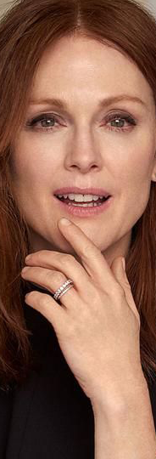
L'Oréal Brand Name
Acceptor/Rejector Studies Shows L'Oréal name means more to people
"I didn't know Plénitude was the name of the brand."
"Plénitude doesn't really mean anything – that could be gone and wouldn't make a difference."
Deemphasizing Plénitude and Emphasizing L'Oréal
L'Oréal resonates with people as innovative and high quality
  "Because it's L'Oréal it will be a little more expensive, but also be better quality."
Focusing on L'Oréal as the brand name could bring:
    More brand recognition and understanding
    Positive brand perceptions
Notes:
Brand Name (Jordan): In the market research, we found that the L’Oréal brand name resonated well, but people did not recognize the Plenitude name. We would recommend deemphasizing the Plenitude name and instead emphasizing L’Oréal brand. We know that the L’Oréal name resonates as innovative and high-quality.
NEXT: Matt

Slide 21
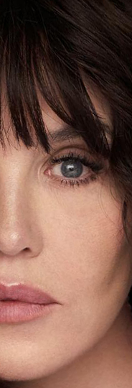
The Product Line
Identifying segments and developing products around them
Regimens by age-group
Maintain high-tech treatment products for "Stressed Out, Age-Focused" customers
Develop a daily moisturizer and regimen specific for the 30s–40s age segment
  Focus on U.S. expectations for moisturizer
  Keep branding simple
  Differentiate product messaging
Notes:
The Product Line (Matt): While the market research revealed that consumers felt there were many products in the product line, it’s not easily distinguishable which products are for specific age groups. Splitting out the products by target age group (reduce fine lines vs. reverses the signs of aging), may help the perception that Plénitude is only for older women. Addressing the products’ formulas for a younger age group and US expectations of moisturizer
NEXT: Vinay

Slide 22
Packaging
The first impression of the products in store is overwhelming with text
Lots and lots of details on the package
Shoppers could not identify the use of specific products
Our Recommendations
A clean front-facing package with the details on the back of the package
Highlight the L'Oréal name
Products with useful and clear naming conventions
Notes:
Packaging: (Vinay) The first impression of the products in store is overwhelming with text.
· Packaging is important - after considering the market research, cleaning up the packaging - graphical on front (key messaging), back of package would include details.
· Also determined from market research – “Names for products could be more distinguishable.”
NEXT: Jocelyn

Slide 23
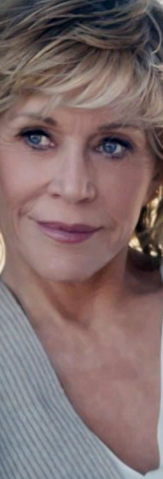
Promotional Strategies
Increasing Awareness and Trial
Of aware consumers, only 29% try Plénitude. Of those who try, only 30% become loyal users.
Celebrity endorsements
  Continued print advertisements in beauty and lifestyle magazines
  Increased television advertisements, more accessible
Promoting Trial
  Coupon for a Plénitude product in newspapers
  Promote skincare regimes
    Highlight benefits for young customers
  Suggest other products on or inside Plénitude packaging
  Highlighting the technological advances of Plénitude over Ponds or Olay to encourage switch
Notes:
Promotion Strategies (Jocelyn): In the Facial Skin Care Market Study, we found that both awareness and trial both have a lot of room to grow. L’Oréal needs to work harder to emphasize the trial of their products.
NEXT: Katie

Slide 24
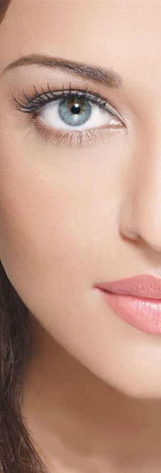
Customer Experience
Class to Mass: Making Department Store Quality Accessible
How will we inform without overwhelming at point of sale?
  Emphasizing the L'Oréal name for perceived quality
  Product regimens with easy-to-follow guidelines for specific ages, promoting these regimens in our advertising
  Updated packaging
Accessibility is key
Notes:
Sales Experience: (Katie) We want to make sure L’Oréal is able to create the department store experience in the HBA aisles of drugstores and big box stores. So the question is, how can L’Oréal inform customers, as if there’s a helpful salesperson present, without overwhelming at the point of sale?
A lot of the recommendations my teammates have already discussed will help achieve this goal – Emphasizing L'Oréal, promoting regimens by age-group, and updating the packaging to appear less overwhelming on the front, with helpful names and categories of regimen, while still providing details elsewhere on the package. These will all play an important role in making the shopping experience easy for the customer without a salesperson.
We want Plenitude products to feel superior to their mass-market competitors, but we need them to remain accessible enough that people will try them. The perceptual map of survey respondents who are familiar with Plenitude place it very close in relation with Clinique and Estee Lauder. People think of L’Oréal Plenitude as a department store quality brand, without the department store prices. This is great. However, these people also identified that the products are “not available where I shop,” indicating that it does not feel like an accessible product. We can do more in-store and in-ads communications to make it clear that Plenitude products are widely available where they shop. Grocery stores, pharmacies, and big box stores all carry the products. With the recommendations we’ve outlined, we think L’Oreal can maintain their superior brand image, while still making it clear that the product is easy to purchase.

Slide 25

THANK YOU
L'Oréal of Paris
Plénitude
Jordan Borkland
Vinay Gandhi
Jocelyn Green
Matthew Kopyt
Katie Marquardt
jeb475@drexel.edu
vg443@drexel.edu
jg3675@drexel.edu
mtk57@drexel.edu
krm342@drexel.edu

